Slide 1
Apple Stock Prediction
By Almon Steven Bate

Slide 2
Introduction
Predicting the stock market is one of the most lucrative and challenging projects in the world.
  It is so challenging because it isn’t just about finding a pattern in data, it is a study of human behavior and how we react to new events.
  If done so accurately though you would stand to make a lot of money.
As such this project will focus on predicting the high price for Apples Stock.

Slide 3
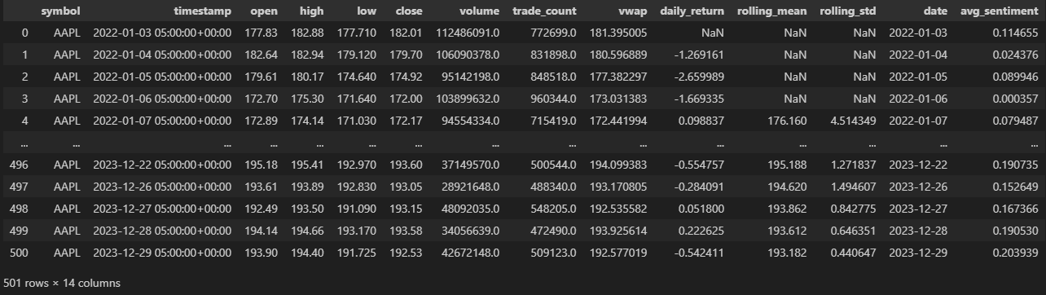
Methodology
Data was gathered from Alpaca.
  Data included stock history data.
  News articles from Benzinga.
All data is then cleaned in python and joined together.
News articles have sentiment analysis performed on them to see if they were positive or negative.
All data is then split, using the first 80% of data as training and the last 20% as testing.
We then use these as features for more ML models.

Slide 4
Features used
The dataset when it came in was a time series, high for day = X, low for day = Y.
I then took this data and created several lag features.
All news was taken for each corresponding day in my data set, using a Textblob I performed a sentiment analysis on it.
  This then made a number -1 – 1. This number was how positive or negative the news article was towards Apple on that given day.

Slide 5
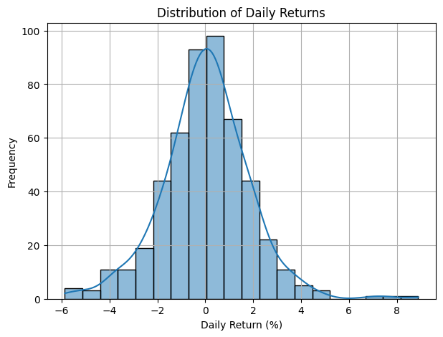
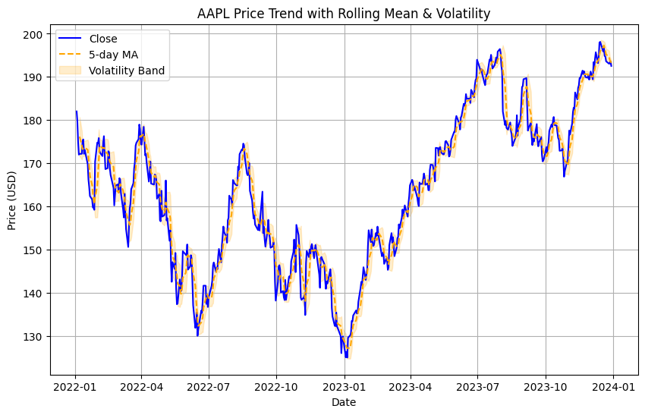
EDA
Apple has low volatility day to day.
Its daily return shows an almost perfect normal form graph meaning that it is generally stable, as hopefully predictable.

Slide 6
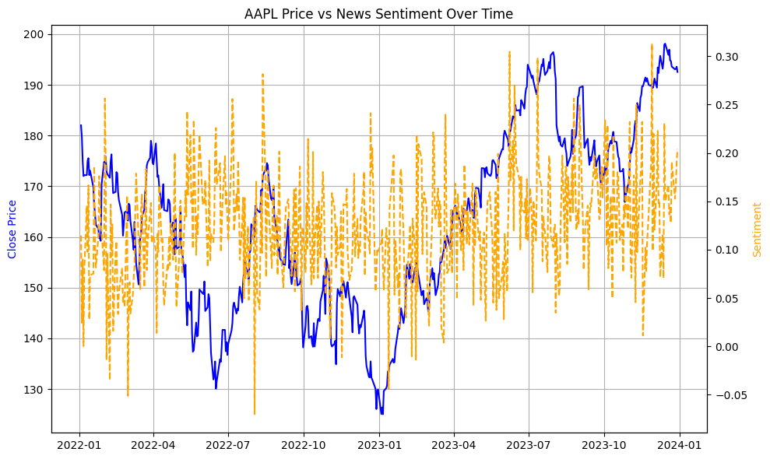
Sentiment Analysis
The sentiment analysis yielded mixed results, visually I couldn’t find much correlation with any ups or downs with Apple.

